Slide 1

AACOMAS Walkthrough
2025-2026 Cycle

Slide 2
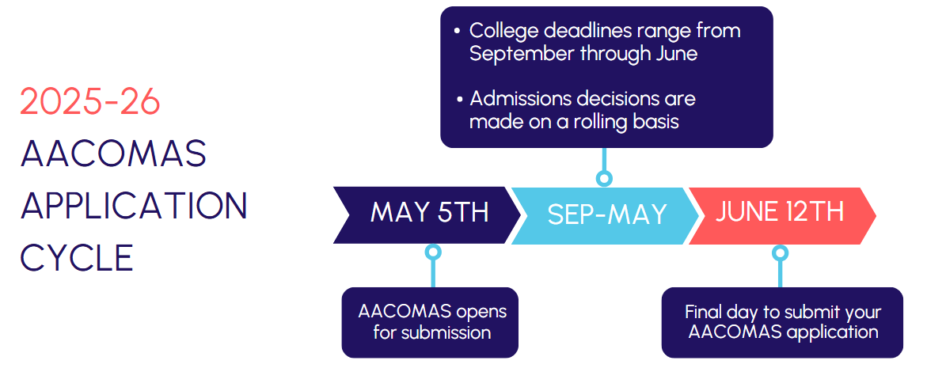

Slide 3
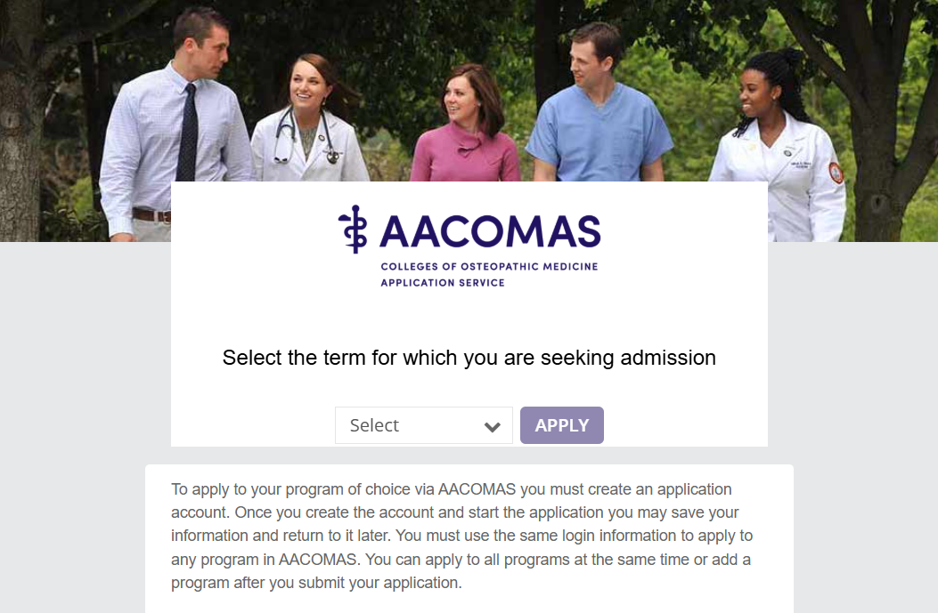
The Application

Slide 4
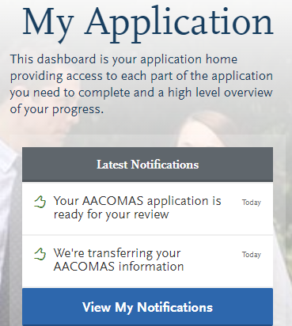

Application Overview – The 4 Quadrants

Slide 5
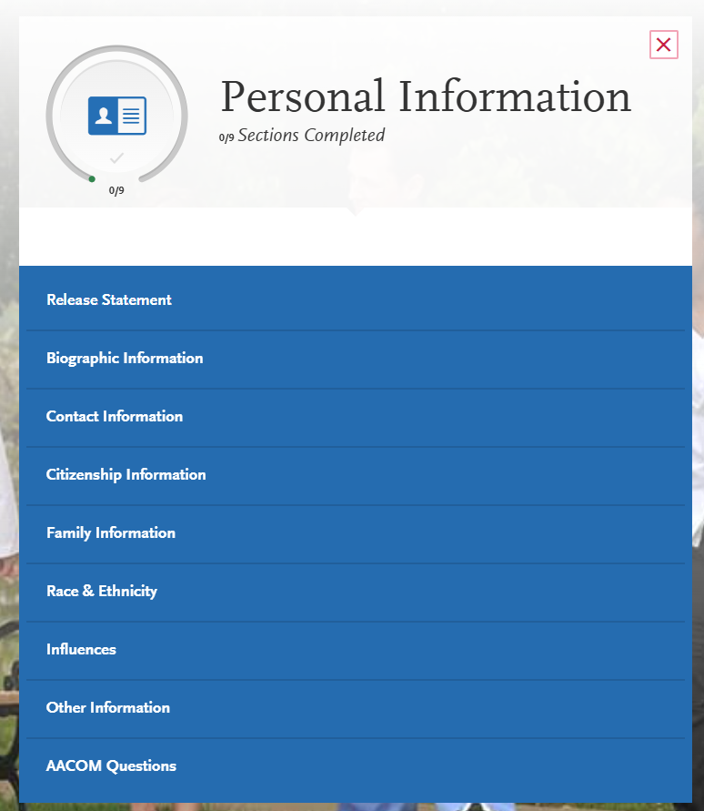

Slide 6
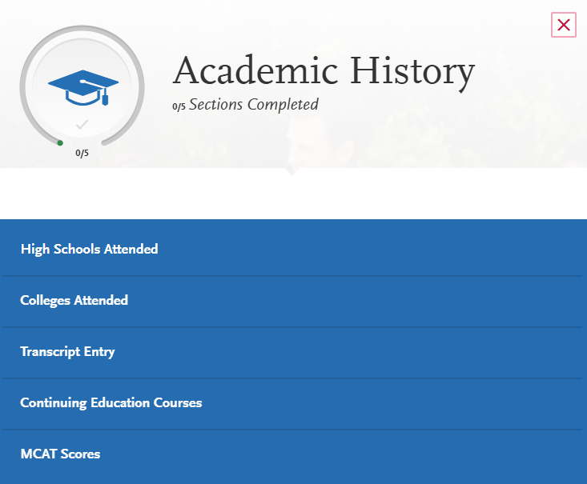

Slide 7
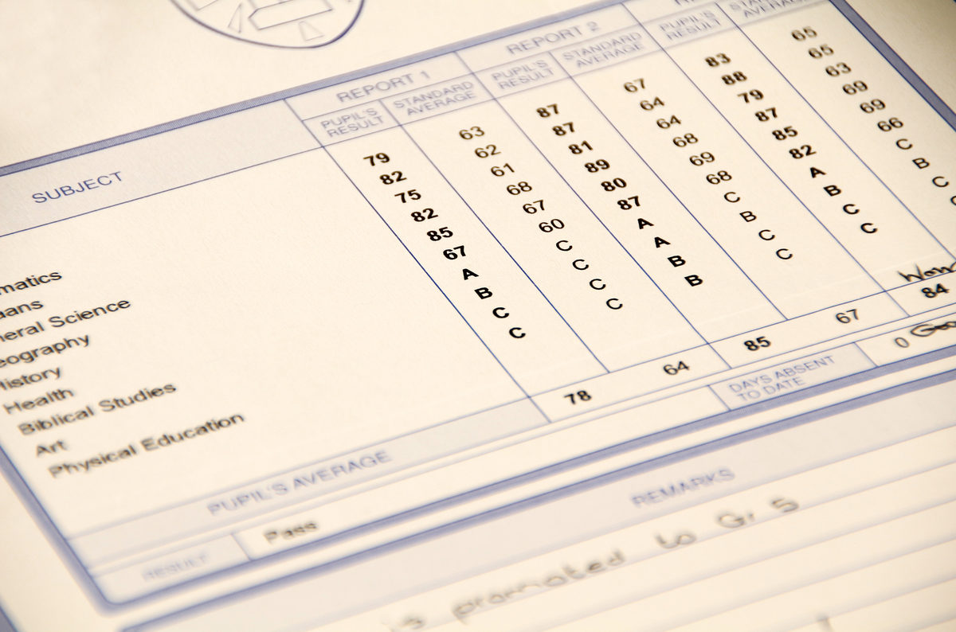

Sending Official Transcripts & MCAT Scores to AACOMAS
Transcripts must be sent to AACOMAS from all US and English-speaking Canadian institutions you listed in the Colleges Attended section of your application, even if the courses later transferred to another institution.
Do not send foreign transcripts (non-US/non-English-Canadian). This includes transcripts from Caribbean and French-Canadian schools.
You must request that AAMC release your MCAT scores to AACOMAS. After AAMC processing, scores are sent to AACOMAS in batches and then posted to applications daily. You can view scores attached to your application in the Standardized Tests section of the Check Status tab.

Slide 8
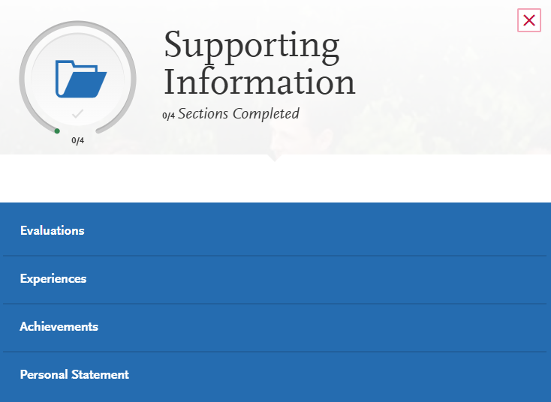

Slide 9
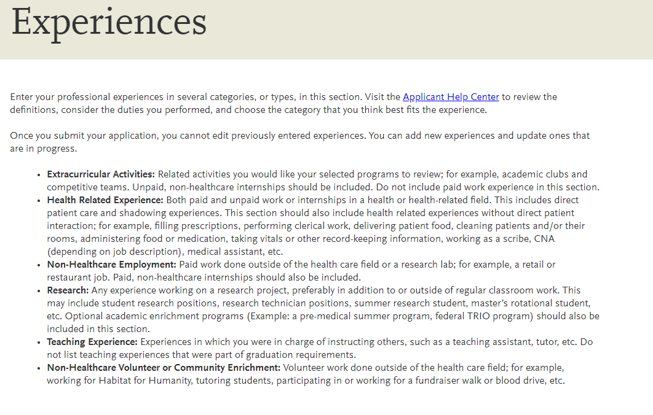

Slide 10
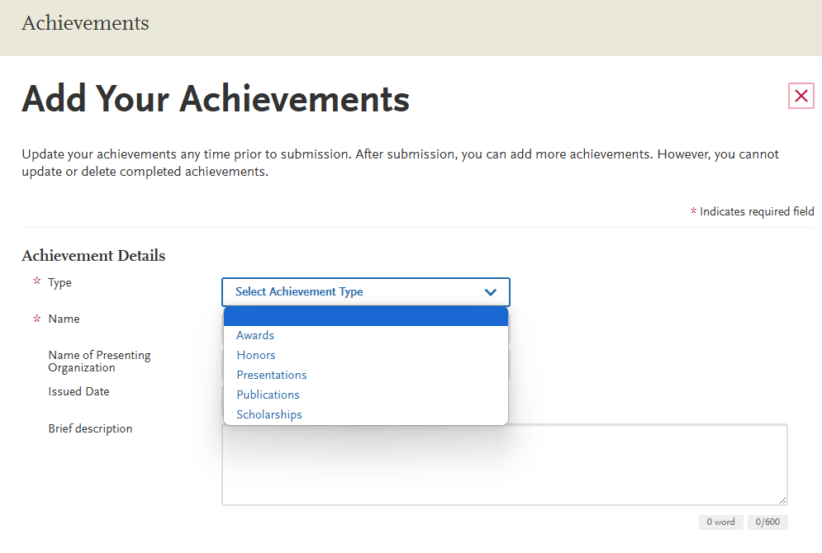

Slide 11
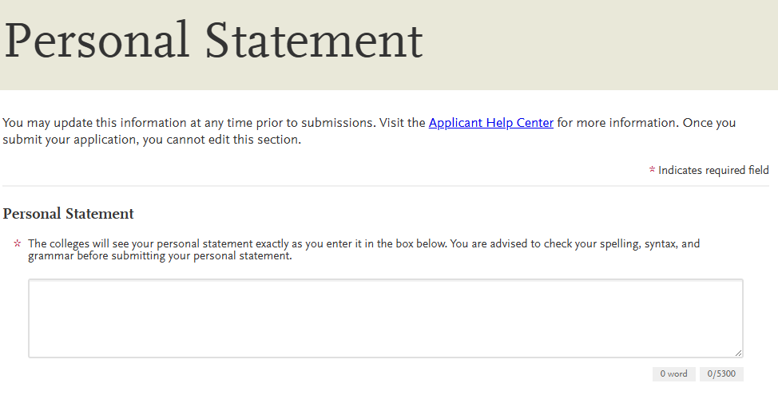

Slide 12

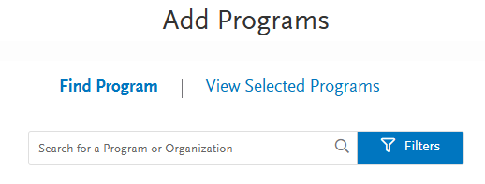
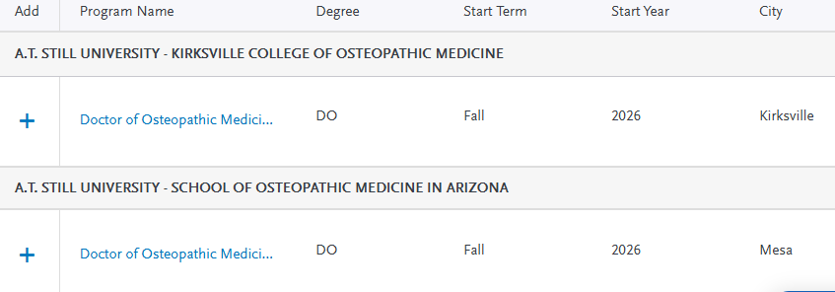

Slide 13
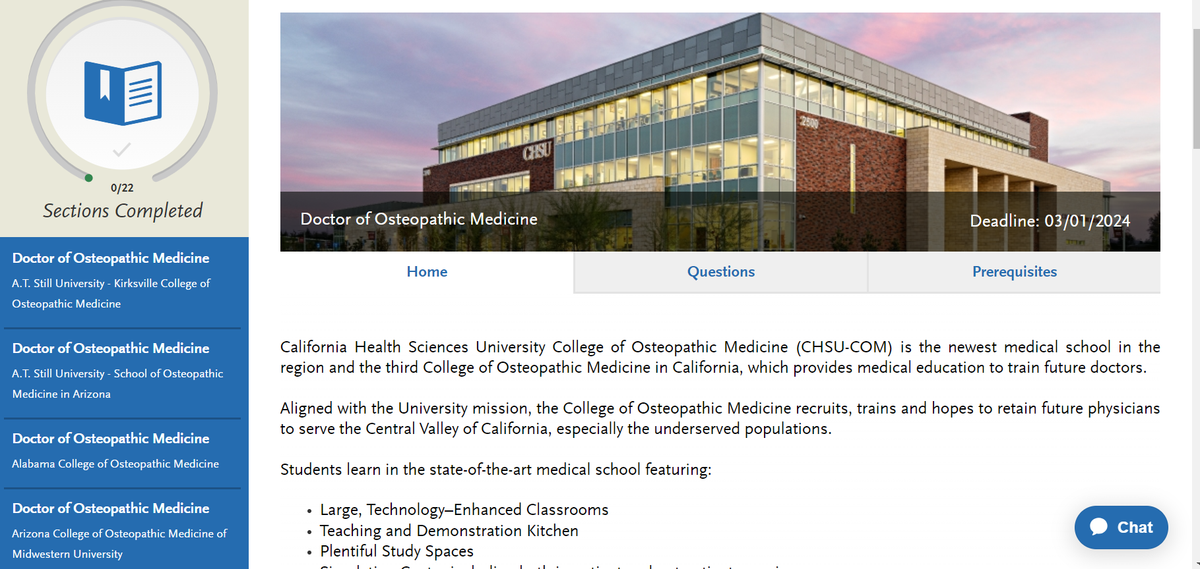
Program Page

Slide 14
What Does it Cost to Apply?
Primary Application fee = $198
Additional Designation = $60
AACOMAS Fee Waiver Program covers the initial application fee only for eligible applicants.
Qualified applicants may be considered for additional waivers at the COM’s discretion

Slide 15
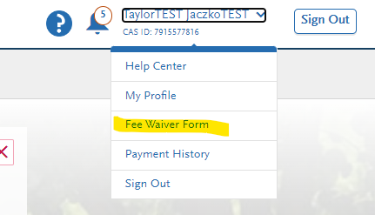
Fee Waiver Program
Fee waiver application is embedded in AACOMAS
Waiver must be requested and decided on BEFORE the AACOMAS application is submitted
If approved, the AACOMAS application MUST be submitted within 14 days or the waiver will be forfeited
Colleges may waive their secondary application fees for students who receive an AACOMAS fee waiver

Slide 16
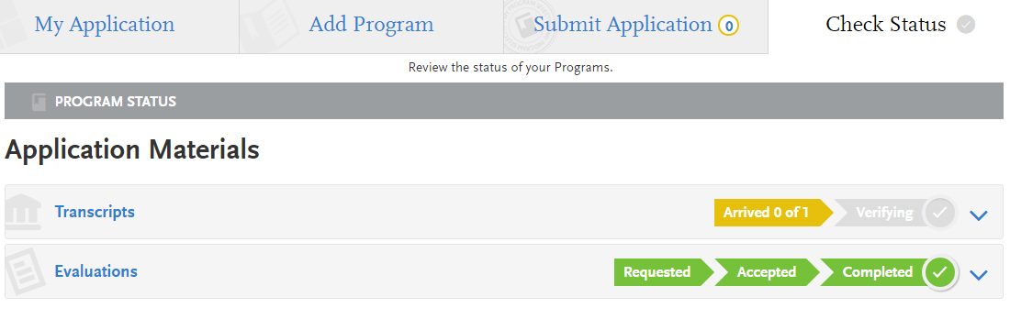
Submitting and Monitoring Your Application
In Progress
Received / Incomplete
Complete
Verified

Slide 17
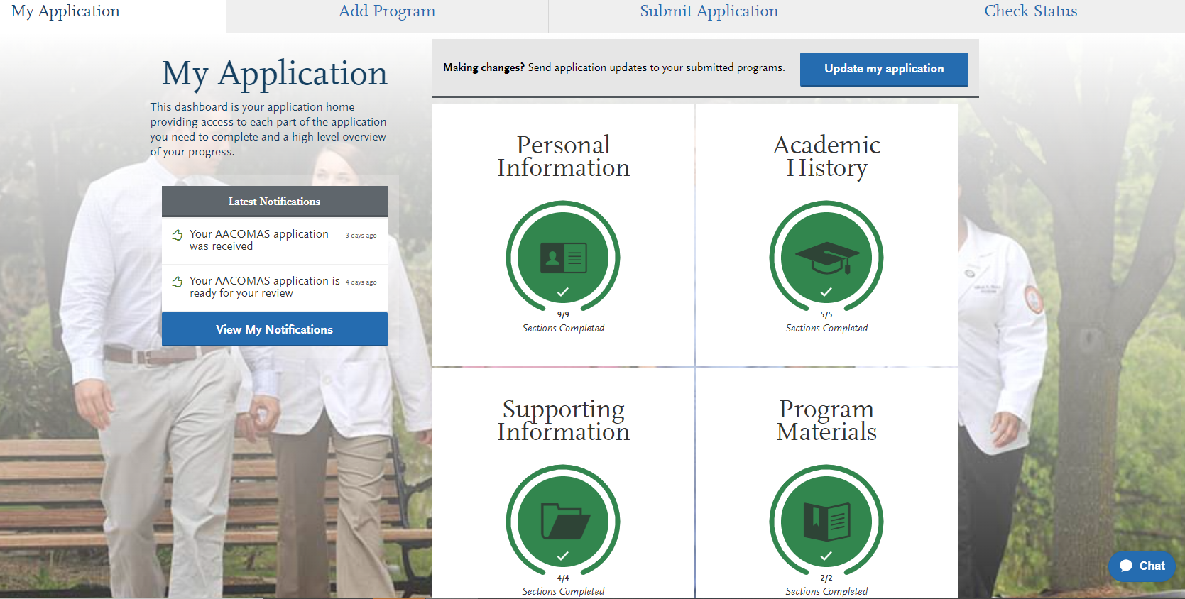
Checking the status of an application

Slide 18
Limited Post-Submission Edits
Once you submit your application, most sections are locked to prevent edits. Updates you can make include:
Editing your contact information.
Editing your profile information (username, password, etc.).
Modifying your release statements
Adding programs with deadlines that have not yet passed.
Adding new evaluations (if you have not yet requested the maximum number of evaluations).
Editing or deleting evaluations that remain incomplete.
Adding new entries to certain areas of the Academic History, Supporting Information, and Program Materials sections (e.g., test scores, experiences, optional documents, etc.), where applicable (you are unable to edit or delete existing entries).
Editing In-Progress Experiences.
Editing program materials for programs you have not yet submitted to.
Adding optional documents to programs that you already submitted to (all other sections will be locked).

Slide 19
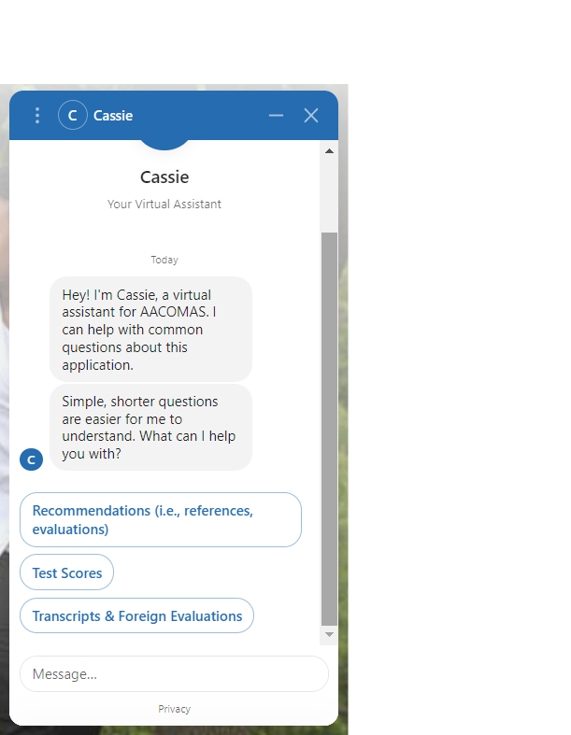
ACOMAS Customer Service
The Applicant Help Center is a fully-searchable resource that contains instructions for filling out each section of the application and sending in all required materials.
AACOMAS Customer Service is open Monday – Friday from 9 am – 5 pm ET
Phone: 617-612-2889
aacomasinfo@liaisoncas.com
Cassie, the Virtual Assistant in AACOMAS

Slide 20

Questions?
The DO Explorer
Regina Bowman-Goldring
Director of Application Services, Recruitment and Student Affairs
RBowman-Goldring@aacom.org
Briana O’Neal
Manager of Application Services and Outreach
boneal@aacom.org

